Slide 1


Slide 2



Slide 3


Slide 4


Slide 5
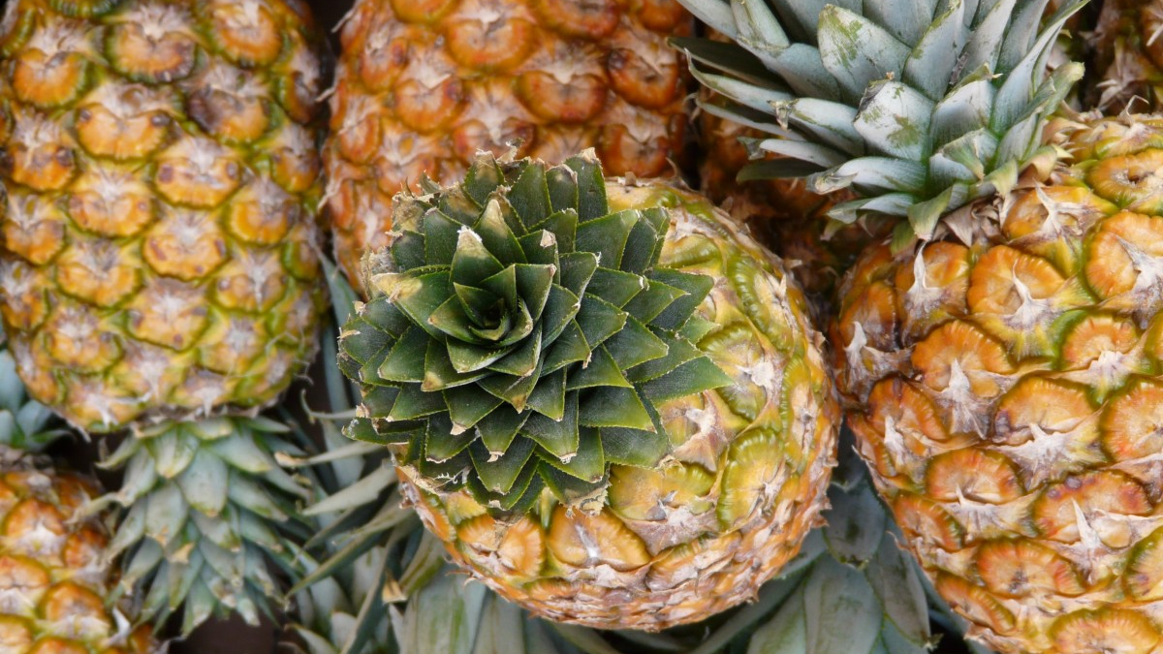

Slide 6


Slide 7


Slide 8


Slide 9


Slide 10


Slide 11


Slide 12

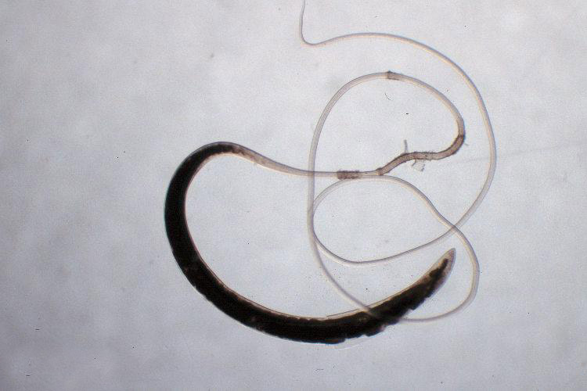

Slide 13


Slide 14


Slide 15

Rich in Vitamins and Minerals: Vitamin C, vitamin A, potassium, and manganese.
Digestive Aid: Pineapple contains bromelain, an enzyme that breaks down proteins. Bromelain may aid in digestion and help prevent bloating and indigestion
Anti-Inflammatory Properties: Bromelain in pineapple has anti-inflammatory effects
Immune System Support: The high vitamin C content in pineapple contributes to a healthy immune system.
Promotes Healthy Skin: Vitamin C is important for collagen synthesis,
Aids in Weight Management: Pineapple is low in calories and high in fiber, making it a satisfying and healthy snack.
Eye Health: Pineapple contains beta-carotene, a precursor to vitamin A, which is essential for eye health.
Heart Health: The potassium content in pineapple may help regulate blood pressure.
Hydration: Pineapple contains more water content, which contributes to hydration.
Anti-Cancer Properties: Some studies suggest that the antioxidants in pineapple, including bromelain, may have anti-cancer properties
Joint Health: Anti-inflammatory properties good for osteoarthritis

Slide 16
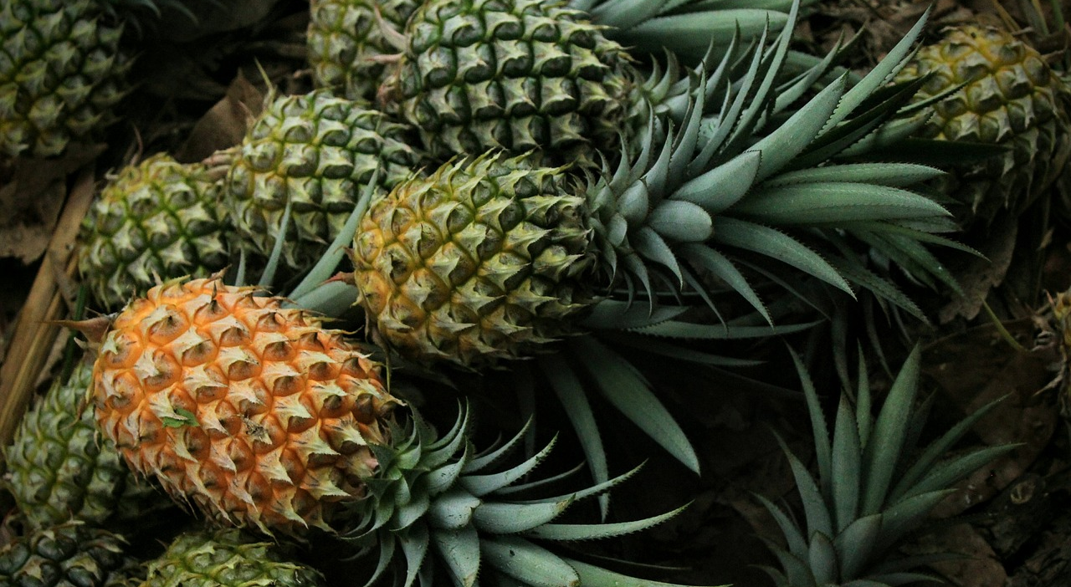
Eating Pineapple Fruit Brings Many Health Benefits
Rich in Vitamins and Minerals: Vitamin C, vitamin A, potassium, and manganese.
Digestive Aid: Bromelain pineapple may aid in digestion and help prevent bloating and indigestion
Anti-Inflammatory Properties: Bromelain in pineapple has anti-inflammatory effects.
Immune System Support: The high vitamin C content in pineapple contributes to a healthy immune system.
Promotes Healthy Skin: Vitamin C is important for collagen synthesis.
Aids in Weight Management: Pineapple is low in calories and high in fiber, making it a satisfying and healthy snack.
Eye Health: Pineapple contains beta-carotene, a precursor to vitamin A, which is essential for eye health.
Heart Health: The potassium content in pineapple may help regulate blood pressure.
Hydration: Pineapple contains more water content, which contributes to hydration.
Anti-Cancer Properties: Some studies suggest that the antioxidants in pineapple, including bromelain, may have anti-cancer properties
Joint Health: Anti-inflammatory properties good for osteoarthritis
www.healthylife.werindia.com

Slide 17
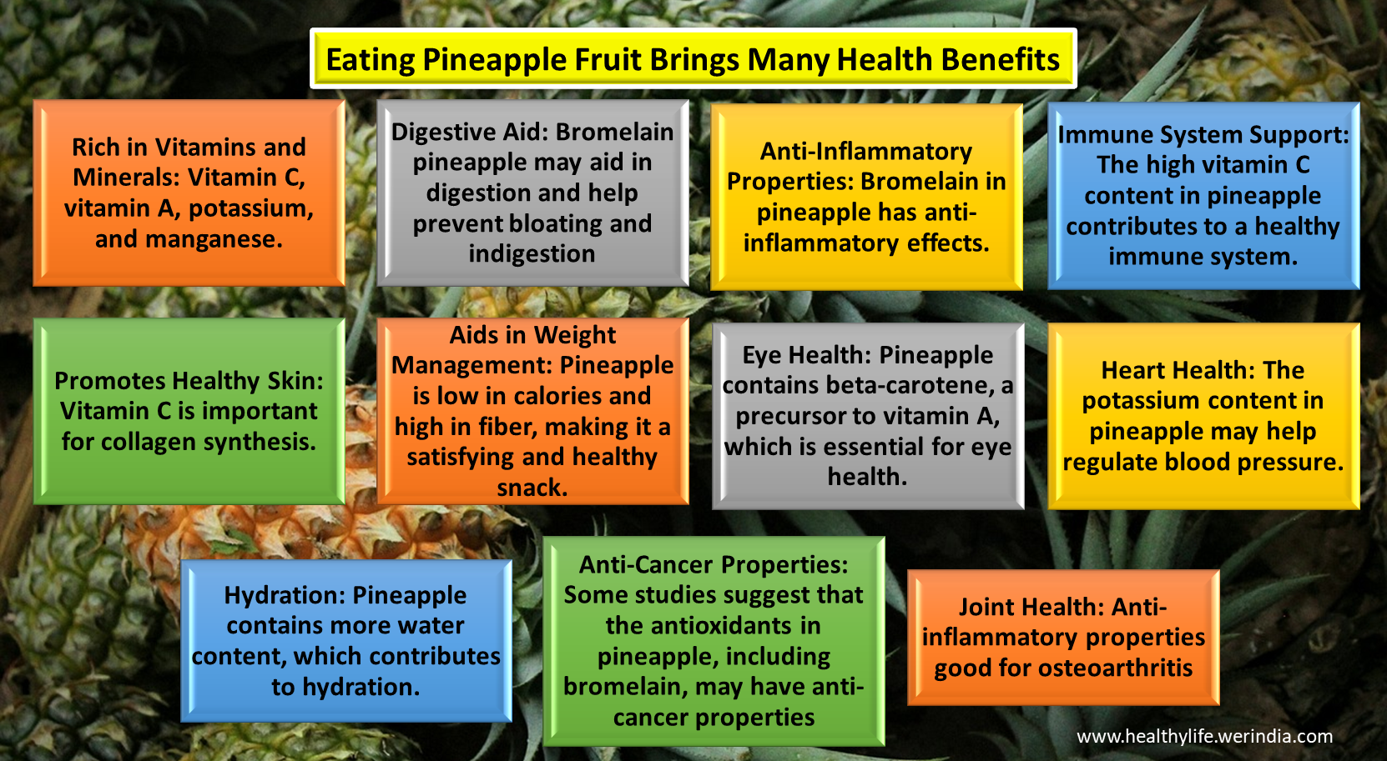

Slide 18
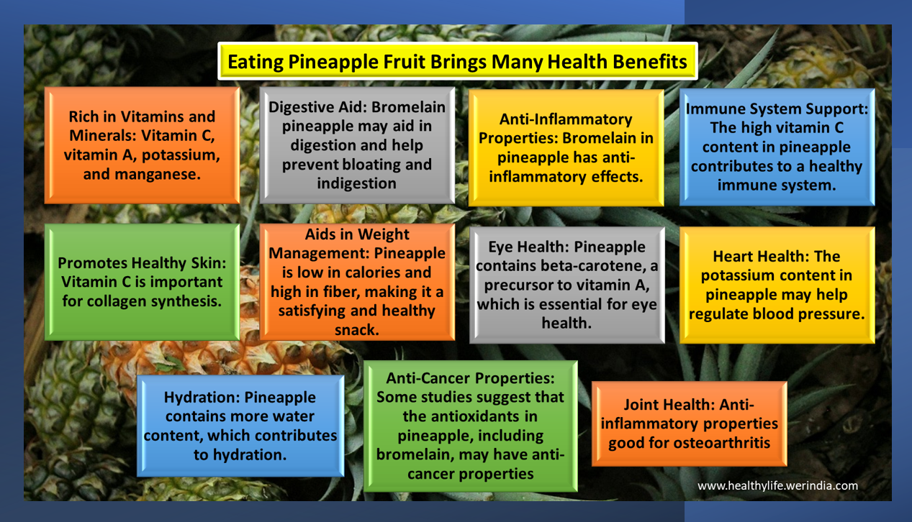

Slide 19


Slide 20
